Slide 1
Econ 200 Module 2 Lecture 5

Slide 3
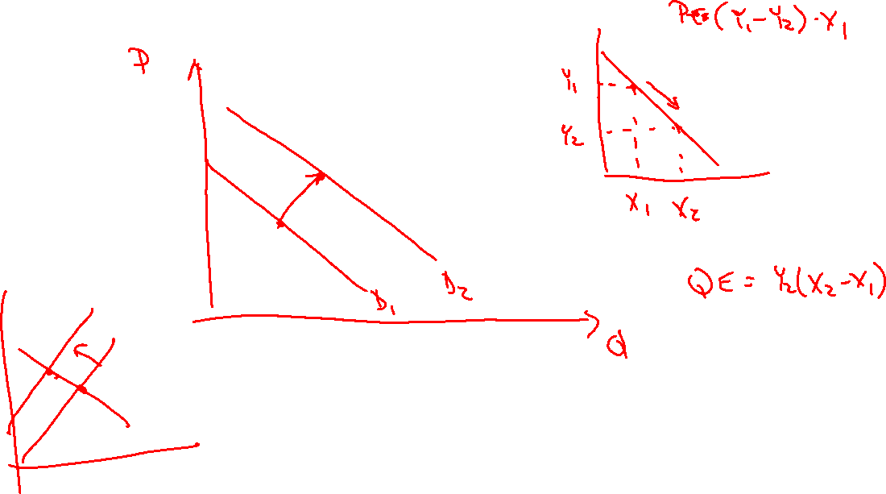

Slide 4
Outline
Elasticity Exercises
Consumer Surplus
Producer Surplus
Economic Efficiency
CS/PS Exercises
Readings: Chapter 5.1-5.4

Slide 5
Four Measures of Elasticity
Measure
Equation
Negative
Positive
More elastic
Less elastic
Price
Over time, for
In the short
Elasticity of
% change in quantity demanded
substitutable
run, for unique
% change in price
Always
Never
goods and
and necessary
Demand
luxury items
items
Price
Over time,
In the short
Elasticity of
% change in quantity supplied
Always
with flexible
run, with
% change in price
Never
production
Supply
production
constraints
For near-
perfect
Cross-Price
% change in quantity demanded of A
For
For
substitutes
For loosely
Elasticity
% change in price of B
comple-
ments
substitutes
and strong
related goods
complements
Income
% change in quantity demanded
For
inferior
goods
For normal
For luxury items
For unique
Elasticity
% change in income
goods
with close
and necessary
substitutes
items
Notes:
The following table summarizes the four measures of elasticity.

Slide 6
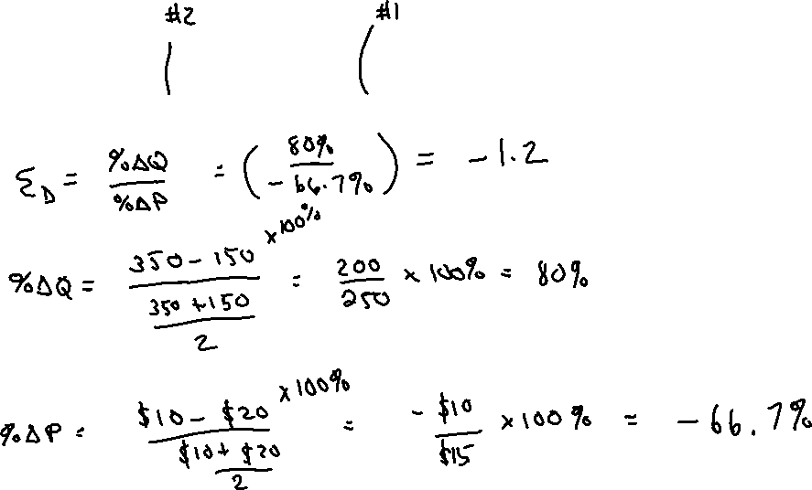
Find the price elasticity of demand using the midpoint formula for the points along a demand curve: ($10,350) and ($20,150).
Notes:
The book does not use a notation for price elasticity of demand. For neatness of presentation, this presentation uses the standard ε_{d} to notate the price elasticity of demand.

Slide 7
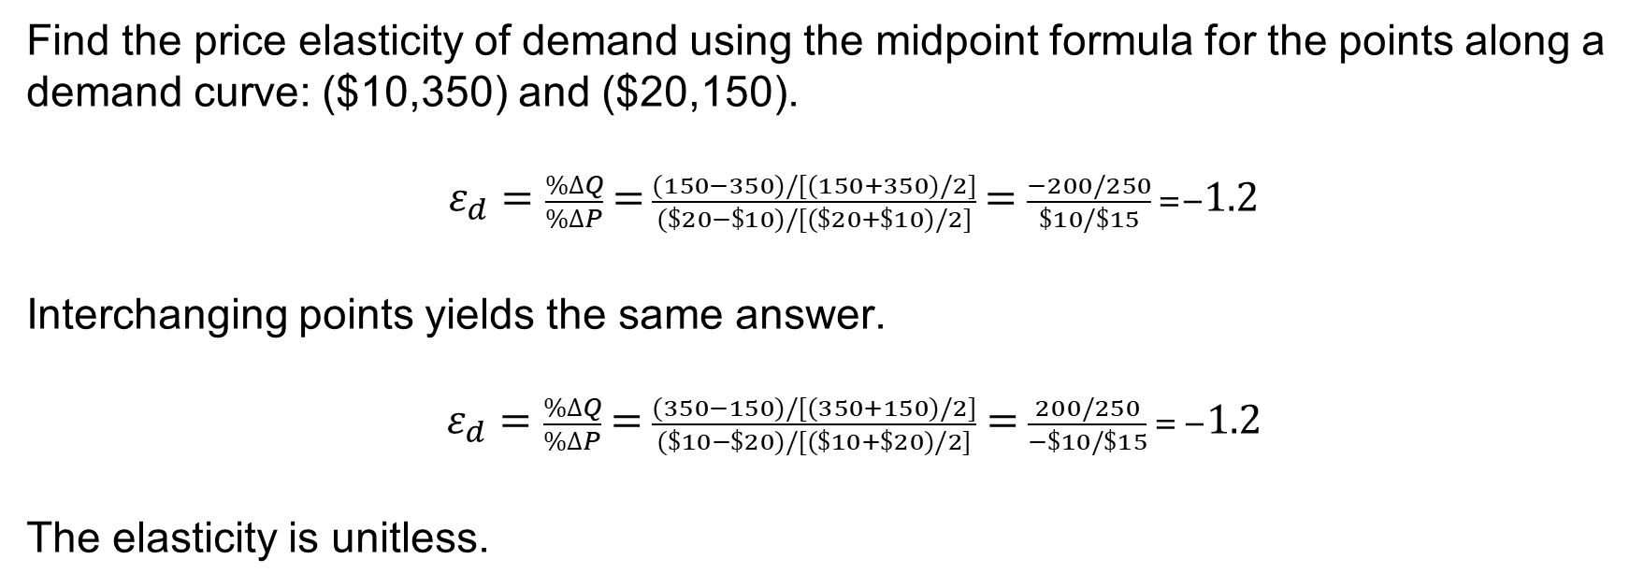
Find the price elasticity of demand using the midpoint formula for the points along a demand curve: ($10,350) and ($20,150).
$ε_{d}=\frac{\%∆Q}{\%∆P}$ =$\frac{(150−350)/[(150+350)/2]}{(\$20−\$10)/[(\$20+\$10)/2]}$ = $\frac{−200/250}{\$10/\$15} =−1.2$
Interchanging points yields the same answer.
$ε_{d}=\frac{\%∆Q}{\%∆P}$ = $\frac{(350−150)/[(350+150)/2]}{(\$10−\$20)/[(\$10+\$20)/2]}$ = $\frac{200/250}{−\$10/\$15} = −1.2$
The elasticity is unitless.
Notes:
The elasticity being unitless means that it is a number, but doesn’t have a standard unit of measure. The elasticity must be interpreted based on its sign and its magnitude.

Slide 8
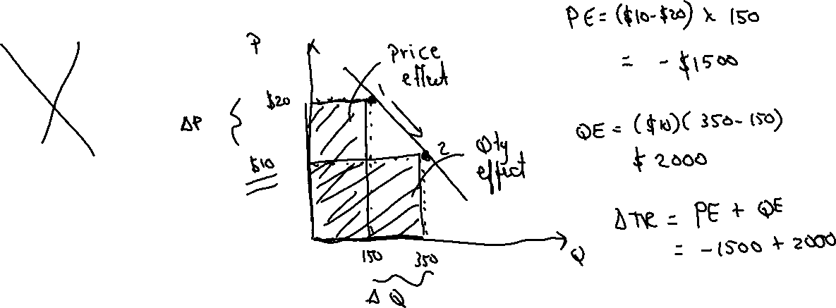
Find the change in total revenue using the following two points along a demand curve: ($20,150) and ($10,350). (Price is falling.)
While you’re at it, what are the price and quantity effects?
$600
$500
-$500
-$600
Notes:
The book does not use a notation for price elasticity of demand. For neatness of presentation, this presentation uses the standard ε_{d} to notate the price elasticity of demand.

Slide 9
Find the change in total revenue using the following two points along a demand curve: ($20,150) and ($10,350). (Price is falling.)
P
The total change in revenue is P₂Q₂-P₁Q₁=$10*350-$20*150=$3500-$3000= $500
You can break this down into a quantity effect of +$2000
And a price effect of -$1500
Price effect
$20
$10
Qty effect
150
350
Q
Notes:
The book does not use a notation for price elasticity of demand. For neatness of presentation, this presentation uses the standard ε_{d} to notate the price elasticity of demand.

Slide 10
So far we have learned that the market (a collection of many buyers and sellers) sets the price. Are we happy with that? Should we (as a society) ever intervene?
→Society may choose to intervene in markets when the market outcome is not equitable (must define this) or the market fails.

Slide 11
Should the Government Control Apartment Rents?
Rent control puts a legal limit on the rent that landlords can charge for an apartment.
Does it make tenants better off? What about landlords? How should we measure that?
We can start to understand the consequences of government intervention by returning to efficiency and a new concept – surplus!

Slide 12
Consumer and Producer Surplus
Surplus : Something that remains above what is used or needed
(Not the same as excess supply)
Consumer surplus is the difference between the highest price a consumer is willing to pay for a good or service and the actual price the consumer pays.
Producer surplus is the difference between the lowest price a firm would be willing to accept for a good or service and the price it actually receives.

Slide 13
Consumer Surplus
Consumer surplus is the difference between the highest price a consumer is willing to pay for a good or service and the actual price the consumer pays.
How much is a consumer willing to pay (WTP)?
Economists call the maximum price that consumers are willing to pay for the marginal good the marginal benefit of that good, and the demand curve can be called the marginal benefit curve.

Slide 14
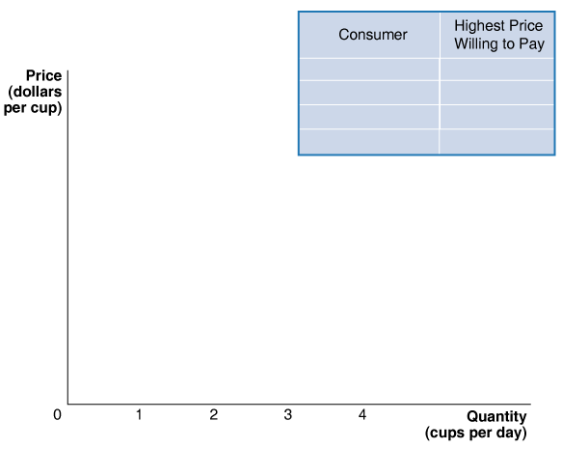
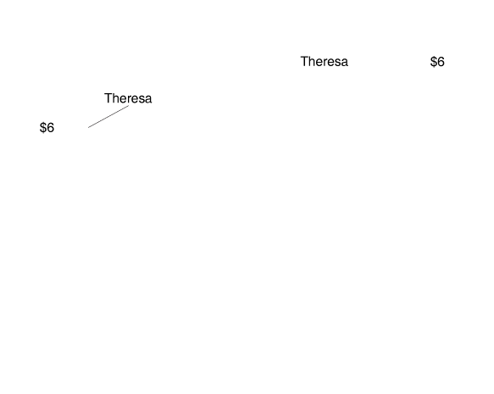
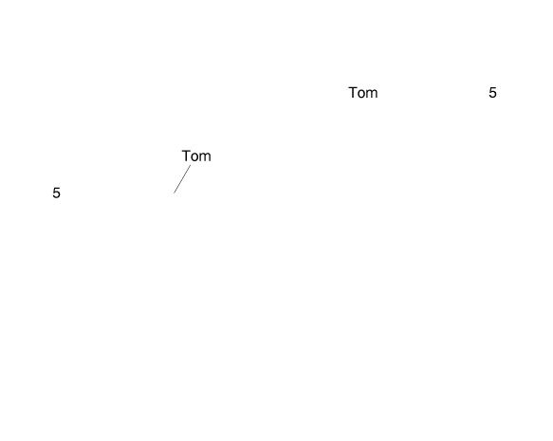
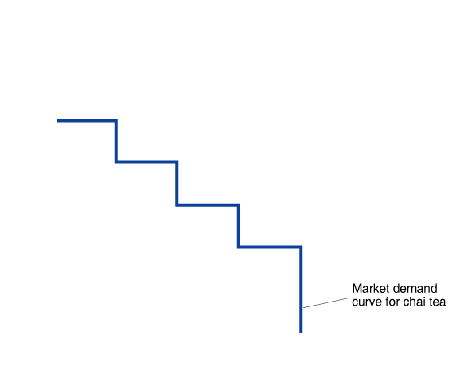
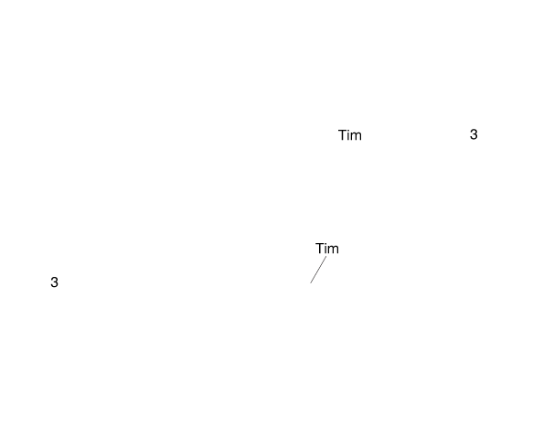
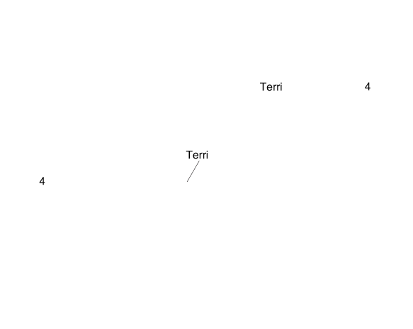
Deriving the Demand Curve for Chai Tea
Suppose four people are each interested in buying a cup of chai tea.
We can characterize them by the highest price they are willing to pay.
At prices above $6, no chai tea will be sold.
At $6, one cup will be sold, etc.
Notes:
With four consumers in the market for
chai tea, the demand curve is determined
by the highest price each consumer is
Willing to pay. For prices above $6, no tea
is sold because $6 is the highest price any
Consumer is willing to pay. For prices of $3
and below, each of the four consumers is
willing to buy a cup of tea.

Slide 15
How Much Benefit Will Chai Tea Drinkers Receive?
That depends on the price and their marginal benefit, the additional benefit to a consumer from consuming one more unit of a good or service.
If the price is low, many of the consumers benefit.
If the price is high, few (if any) of the consumers benefit.

Slide 16
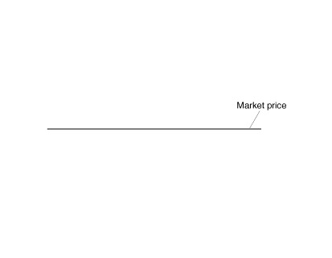
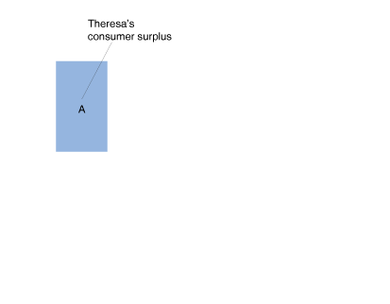
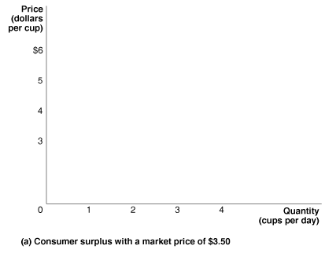
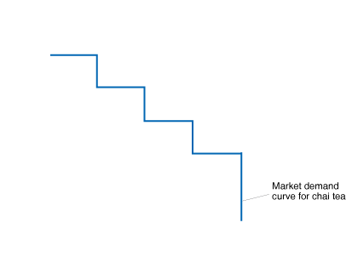
Consumer Surplus at a Price of $3.50
Theresa was willing to pay $6.00; a cup of chai tea is “worth” $6.00 to her.
She got it for $3.50, so she derives a net benefit of $6.00 – $3.50 = $2.50.
Area A represents this net benefit, and is known as Theresa’s consumer surplus in the chai tea market.
Notes:
Panel (a) shows the consumer surplus for Theresa, Tom, and Terri when the price of
tea is $3.50 per cup. Theresa’s consumer surplus is equal to the area of rectangle A
and is the difference between the highest price she would pay—which is $6—and the
market price of $3.50. Tom’s consumer surplus is equal to the area of rectangle B, and
Terri’s consumer surplus is equal to the area of rectangle C. Total consumer surplus in
this market is equal to the sum of the areas of rectangles A, B, and C, or the total area
below the demand curve and above the market price. In panel (b), consumer surplus
increases by the dark blue area as the market price declines from $3.50 to $3.00.

Slide 17
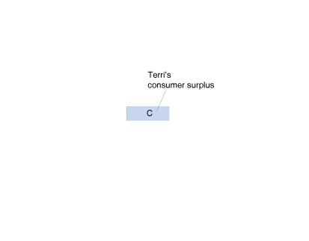
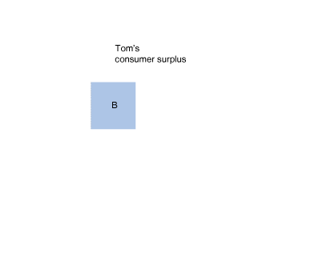

Consumer Surplus at a Price of $3.50—continued
Tom and Terri also obtain consumer surplus, equal to $1.50 (area B) and $0.50 (area C).
The sum of the areas of rectangles A, B, and C is called the consumer surplus in the chai tea market.

Slide 18
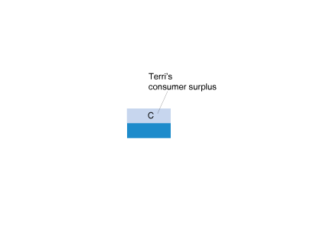
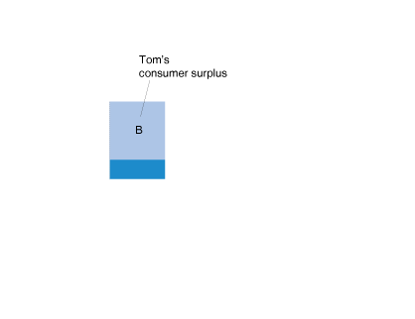
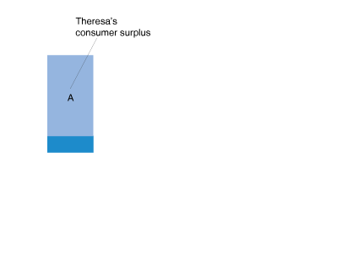
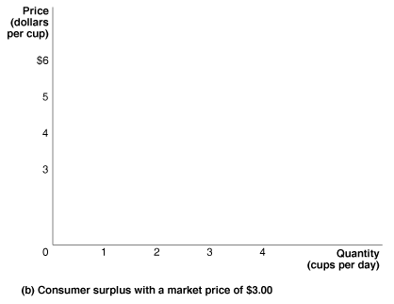
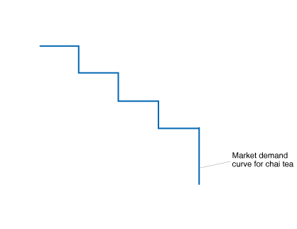
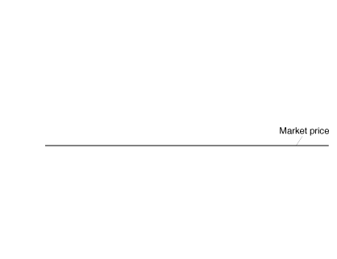
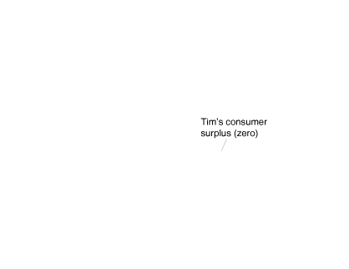
Consumer Surplus If Price Falls to $3.00
If the price falls to $3.00, Theresa, Tom, and Terri each gain an additional $0.50 of consumer surplus.
The overall consumer surplus remains the area below the demand curve, above the (new) price.

Slide 19
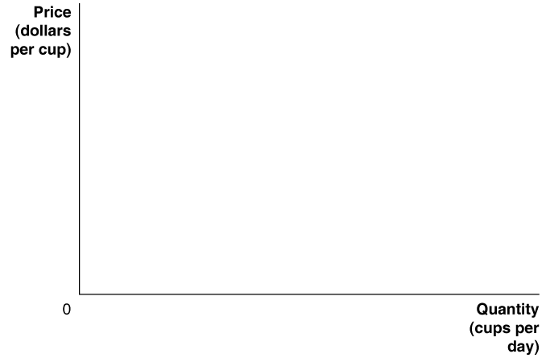

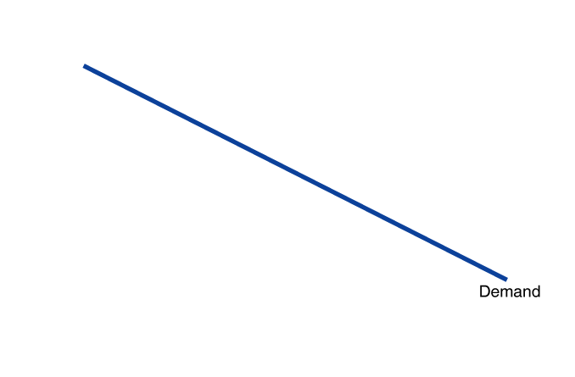
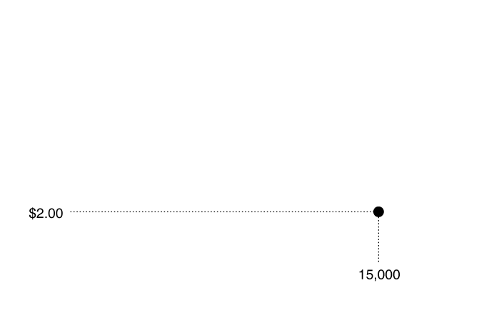
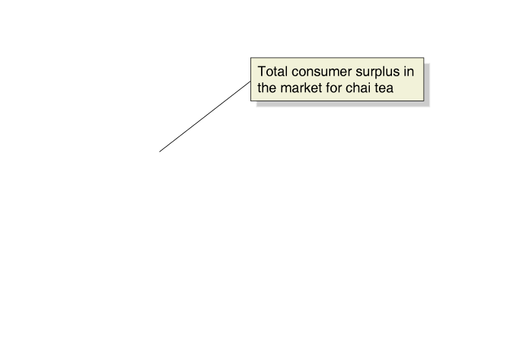
Total Consumer Surplus in the Market for Chai Tea
The market for chai tea is larger than just our four consumers.
Consumer surplus in this market = the area below the demand curve, above price.
Notes:
The demand curve shows that most buyers
of chai tea would have been willing to pay
more than the market price of $2.00. For
each buyer, consumer surplus is equal to
the difference between the highest price he
or she is willing to pay and the market price
actually paid. Therefore, the total amount of
consumer surplus in the market for chai tea
is equal to the area below the demand curve
and above the market price. Consumer surplus
represents the benefit to consumers in
excess of the price they paid to purchase a
product.

Slide 20
Producer Surplus
Producer surplus can be thought of in much the same way as consumer surplus.
Producer surplus: The difference between the lowest price a firm would accept for a good or service and the price it actually receives.
What is the lowest price a firm would accept for a good or service?
The marginal cost of producing that good or service.
Marginal cost: the additional cost to a firm of producing one more unit of a good or service.

Slide 21
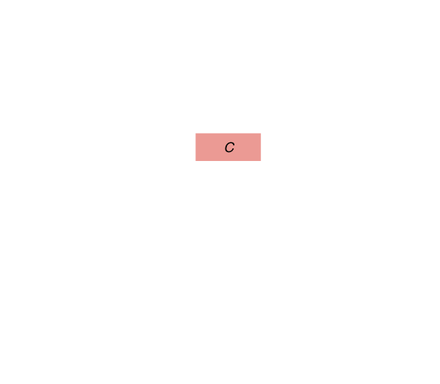
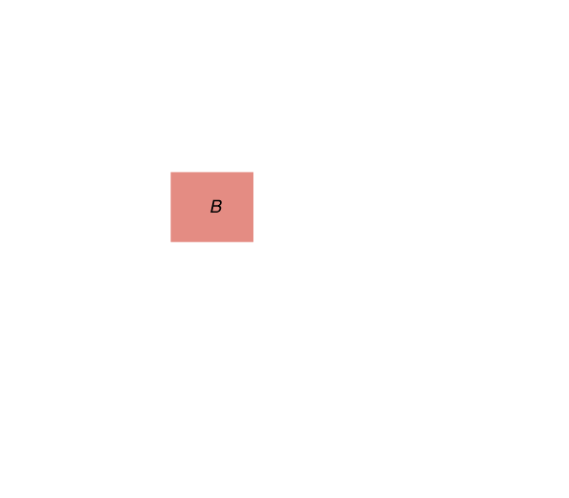
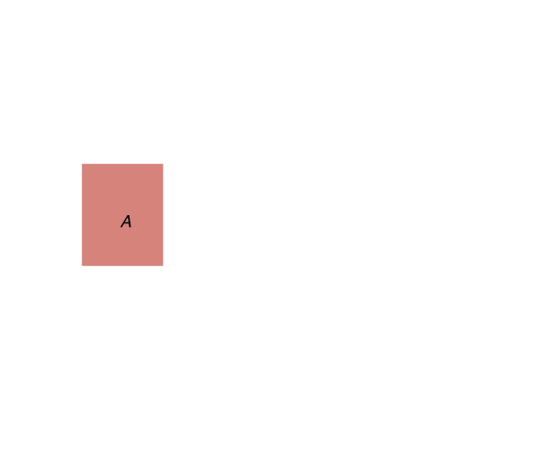
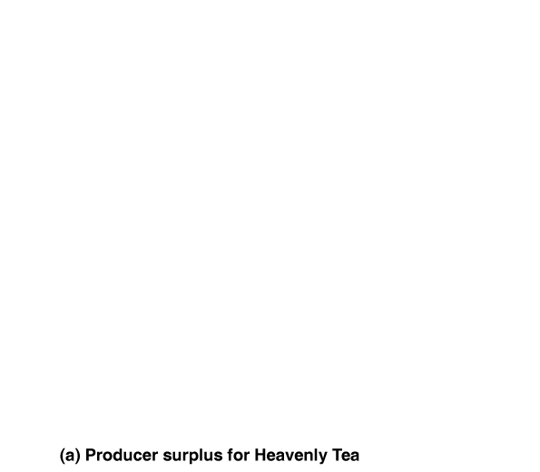
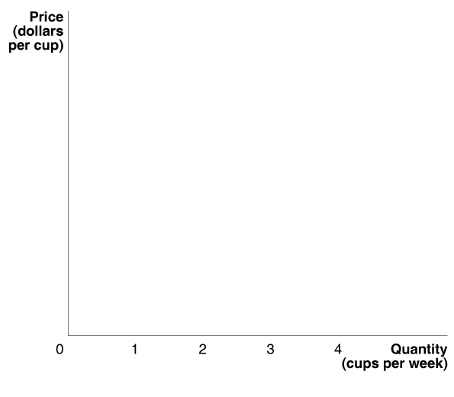
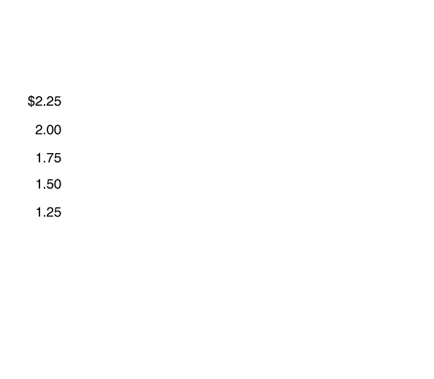
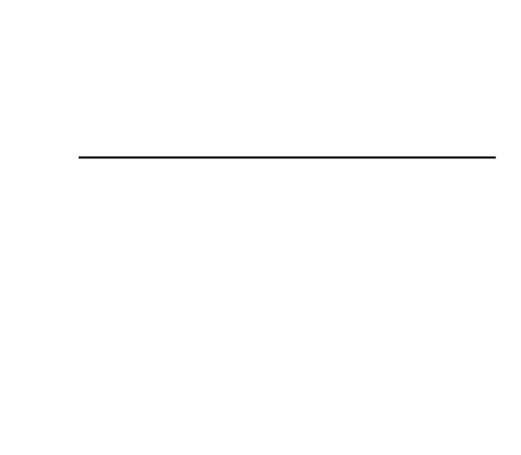
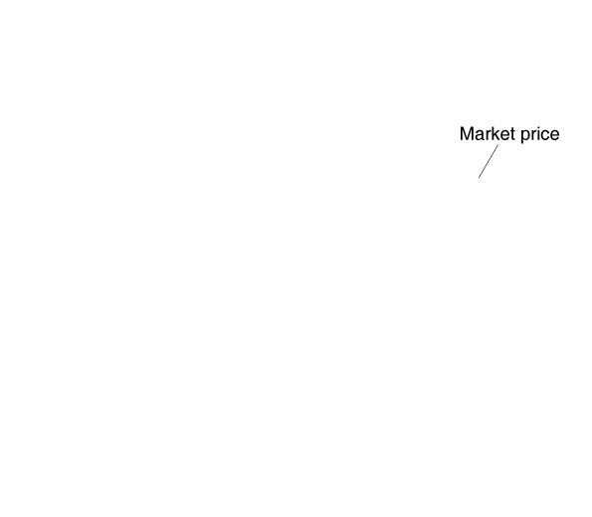
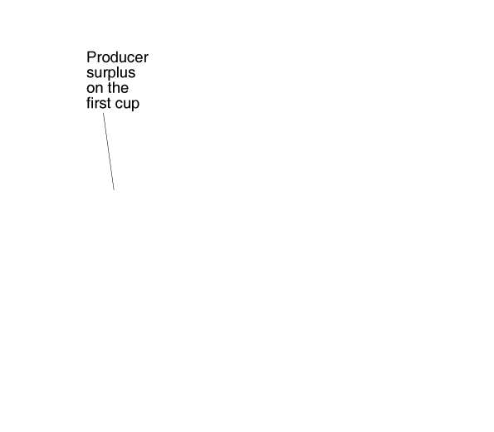
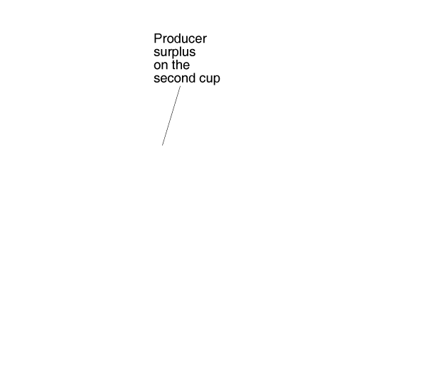
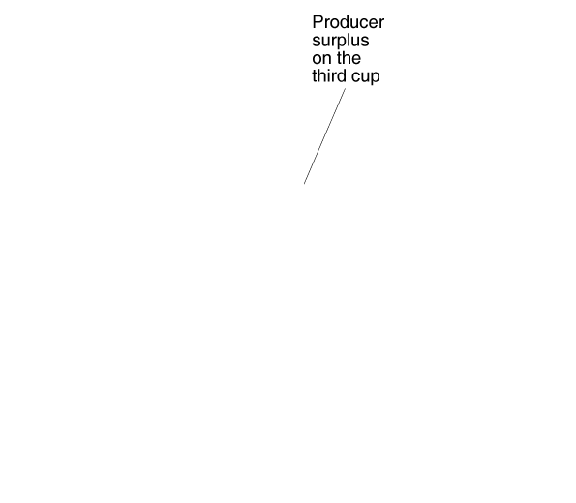
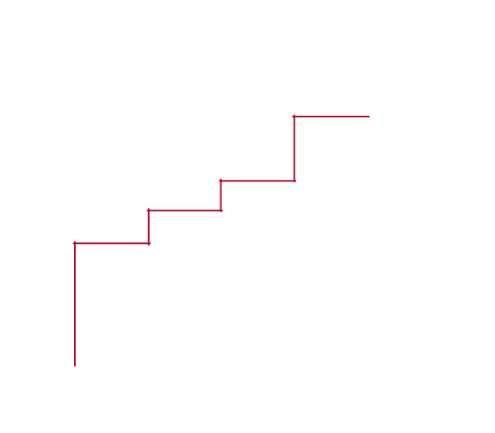
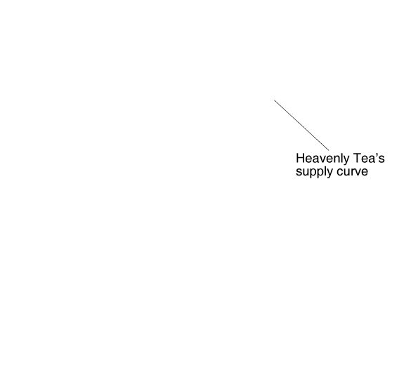
Measuring Producer Surplus (Single Firm)
When the market price of tea is $2.00, Heavenly Tea receives producer surplus of $0.75 on the first cup, $0.50 on the second cup, and $0.25 on the third cup.
Notes:
Panel (a) shows Heavenly Tea’s producer surplus. The lowest price Heavenly
Tea is willing to accept to supply a cup of tea is equal to its marginal cost of
producing that cup. When the market price of tea is $2.00, Heavenly receives
producer surplus of $0.75 on the first cup (the area of rectangle A), $0.50
on the second cup (rectangle B), and $0.25 on the third cup (rectangle C).
In panel (b), the total amount of producer surplus tea sellers receive from
Selling chai tea can be calculated by adding up for the entire market the
Producer surplus received on each cup sold. In the figure, total producer
surplus is equal to the shaded area above the supply curve and below the
market price.

Slide 22
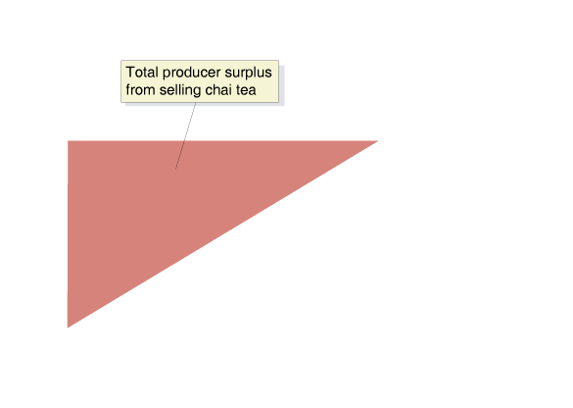
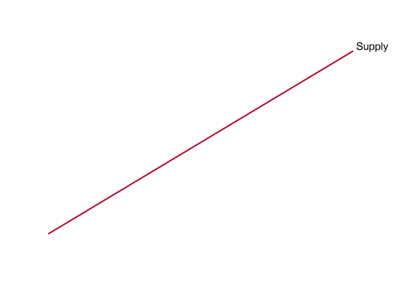
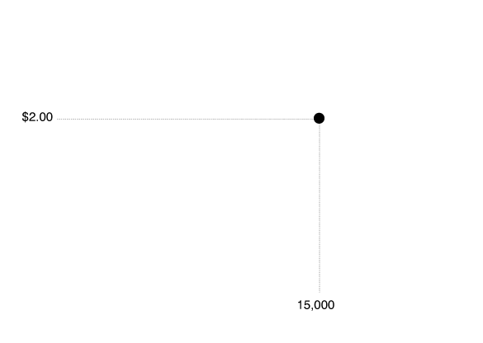
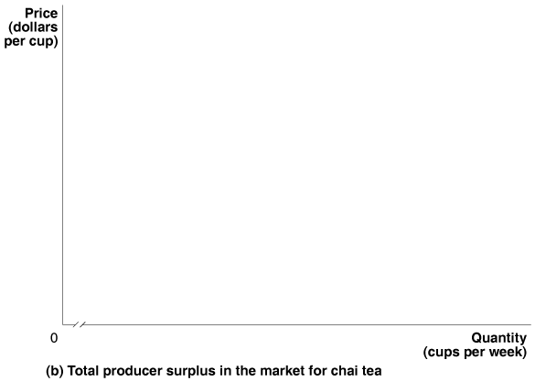
Measuring Producer Surplus (Entire Market)
Total producer surplus is equal to the area above the supply curve and below the market price of $2.00.

Slide 23
What Consumer and Producer Surplus Measure
Consumer surplus measures the net benefit to consumers from participating in a market rather than the total benefit.
Consumer Surplus = Total Benefit – Total Price Paid
Similarly, producer surplus measures the net benefit received by producers from participating in a market.
Producer Surplus = Total Revenue – Total Cost

Slide 24
Use the following demand schedule to calculate consumer surplus if the market price is $5.
Price | Quantity | Consumer Surplus
1 | 160
2 | 140
3 | 120
4 | 100
5 | 80
6 | 60
7 | 40
8 | 20
Notes:
This active learning exercise requires students to calculate consumer surplus (similar to area 1 in the previous slide) by adding up the vertical columns. The column width is no longer one person, but instead the quantity of units being purchased.

Slide 25
Use the following demand schedule to calculate consumer surplus if the market price is $5.
Price | Quantity | Consumer Surplus
1 | 160 | $0
2 | 140 | $0
3 | 120 | $0
4 | 100 | $0
5 | 80 | ($5 - $5)*20 = $0
6 | 60 | ($6 - $5)*20 = $20
7 | 40 | ($7 - $5)*20 = $40
8 | 20 | ($8 - $5)*20 = $60
Those with a maximum willingness to pay below market price do not buy the good.
Those with a maximum willingness to pay equal to market price do not receive consumer surplus.
Those with a maximum willingness to pay above the market price receive consumer surplus.
Consumer surplus = $20 + $40 + $60 = $120

Slide 26
Use the following graph to calculate the consumer and producer surplus when the price is $200.
Price ($)
600
500
400
1
S
300
200
133
2
100
D
0
5
10
15
20
25
30
35
40
45
50
55
60
65
Quantity of cameras (millions)

Slide 27
Use the following graph to calculate the consumer and producer surplus when the price is $200.
Price ($)
CS= ½ ($500-$200)*30 million = $4.5 billion
600
500
PS= ½ ($200-$0)*30 = $3 billlion
400
1
S
300
200
133
2
100
D
0
5
10
15
20
25
30
35
40
45
50
55
60
65
Quantity of cameras (millions)

Slide 28
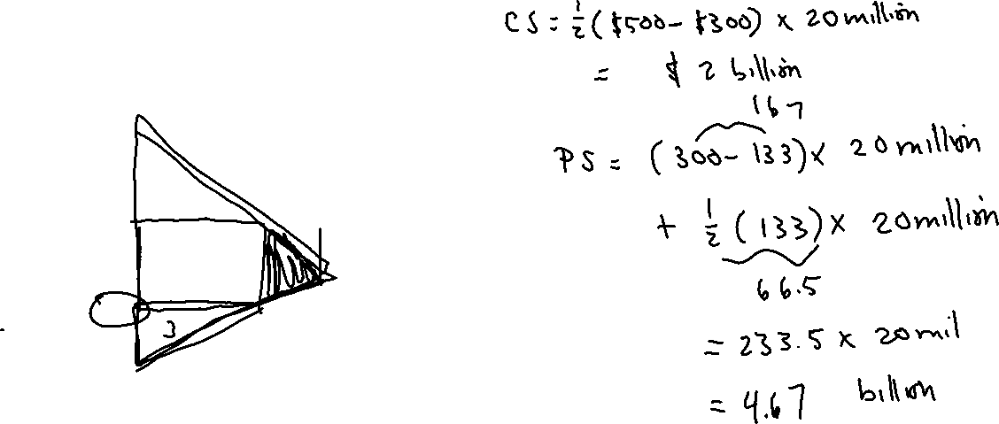
Use the following graph to calculate the total surplus if the price is $300.
Price ($)
600
500
400
1
S
300
2
4
200
5
133
100
D
0
5
10
15
20
25
30
35
40
45
50
55
60
65
Quantity of cameras (millions)

Slide 29
Use the following graph to calculate the total surplus if the price is $300.
CS = ½ × 20M × ($500 - $300) = $2B
PS = $3B - ½ × 10M × ($200 - $133.33) + 20M × ($300 - $200) = $4.66B
Total surplus = $2B + $4.33B = $6.665B
Price ($)
600
500
400
1
S
300
2
4
200
5
133
3
100
D
0
5
10
15
20
25
30
35
40
45
50
55
60
65
Quantity of cameras (millions)

